Slide 1
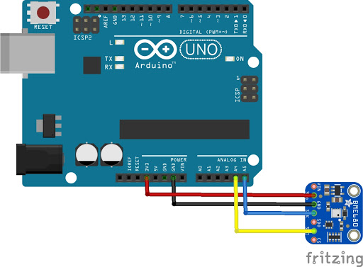
ENEL 301
Group 4 Project Management and Analysis
Presented by: Abhay khosla

Slide 2


Team Communication
Regular meetings held, with clear and concise notes taken for each task
Primary communication through Discord
File sharing done through GitHub

Slide 3
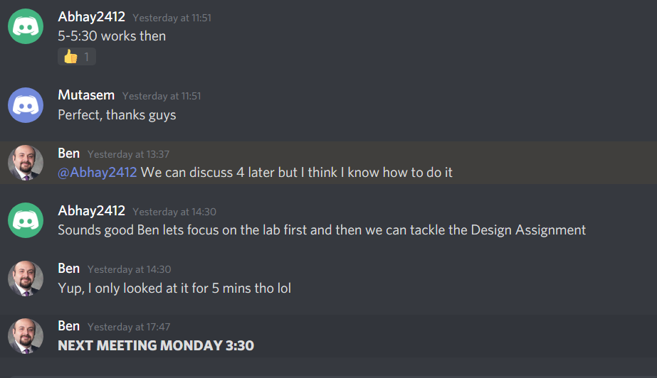
Team Communication

Slide 4

Team Roles
Abhay: Analysis Lead
Worked on the implementation of the motion sensor and figuring out the issues with it.
Ben: Design Lead
Primarily designed the functionality of what each sensor will do and worked on most of the sensor's code.
Mutasem: Implementation lead
Tested the sensors also worked on the EEPROM and investigating the libraries for it.

Slide 5
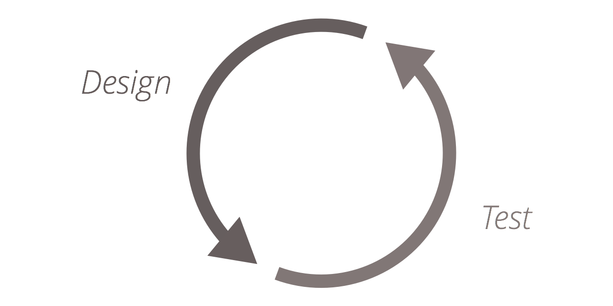
Iterations of ENVIRONMENT SENSORS
The code was straightforward, but still required many iterations needed:
The number of new libraries we needed to explore and what they contained, with the purpose of their usage.
The type of environment we were achieving had to be modified numerous time with finally reaching a conclusion of a security system for the house.
The issue of being able to connect to the Bluetooth saw numerous issues from having to change the device type to being Android.

Slide 6
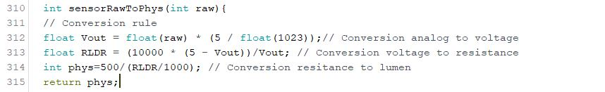
Calculations
The main calculations which were done in this lab are the conversions for the data which was the main aspect to get the right values for it.

Slide 7
Analysis
Reference of EEPROM Libraries:
https://www.arduino.cc/en/Reference/EEPROM
https://forum.arduino.cc/index.php?topic=312645.0
Some resources from online:
https://electronics.stackexchange.com/questions/54/saving-arduino-sensor-data-to-a-text-file
https://www.youtube.com/watch?v=vJgtckLzoKM
https://www.youtube.com/channel/UCfYfK0tzHZTpNFrc_NDKfTA

Slide 8
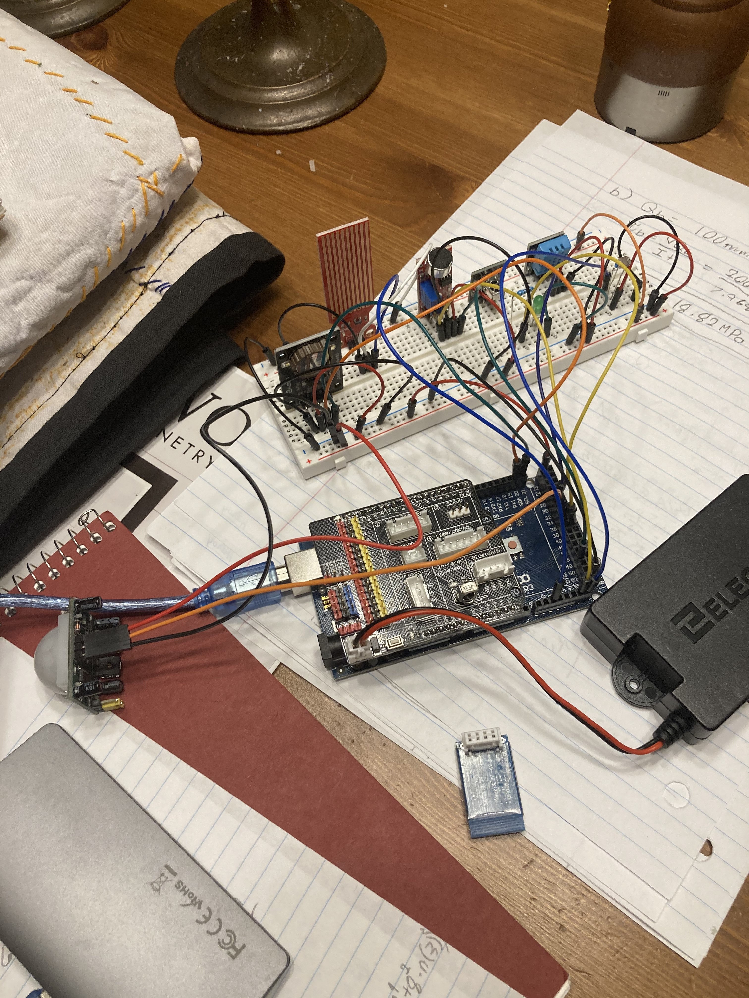
FINAL design
Pictures of the final circuit design of the sensor layouts

Slide 9
Lessons Learned
Plan for the labs and meet every other day for an update for half an hour.
Start working on the project ASAP and accommodate for unforeseen events.
Communication is CRITICAL.
Gather questions for the lab sessions to ask.

